Slide 1

ASPEP
ASSOCIATION OF SCOTTISH PRINCIPAL
EDUCATIONAL PSYCHOLOGISTS
www.aspep.org
Workforce Planning Survey Data
2015,2016,2017 Comparison
ASPEP May 2018
Notes:
This is a front cover page and can only be used at the beginning of a PowerPoint presentation once. Do not add anything else to this screen if it is being used.

Slide 2
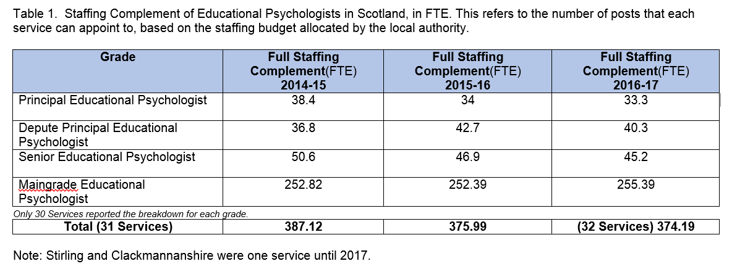
Staffing complement

Slide 3
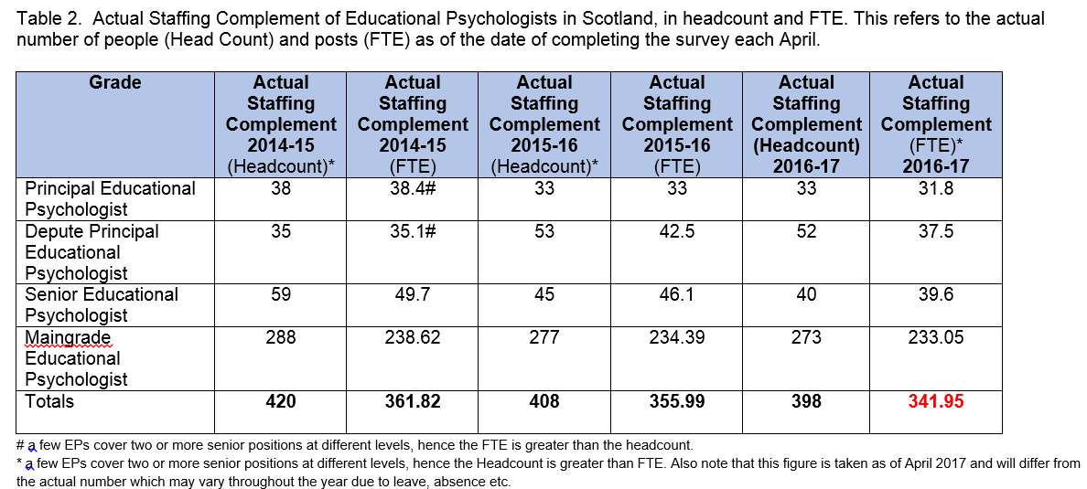
Actual staffing numbers

Slide 4
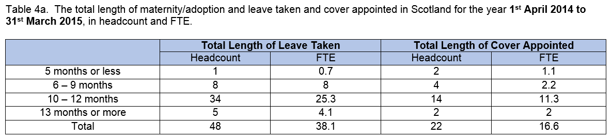
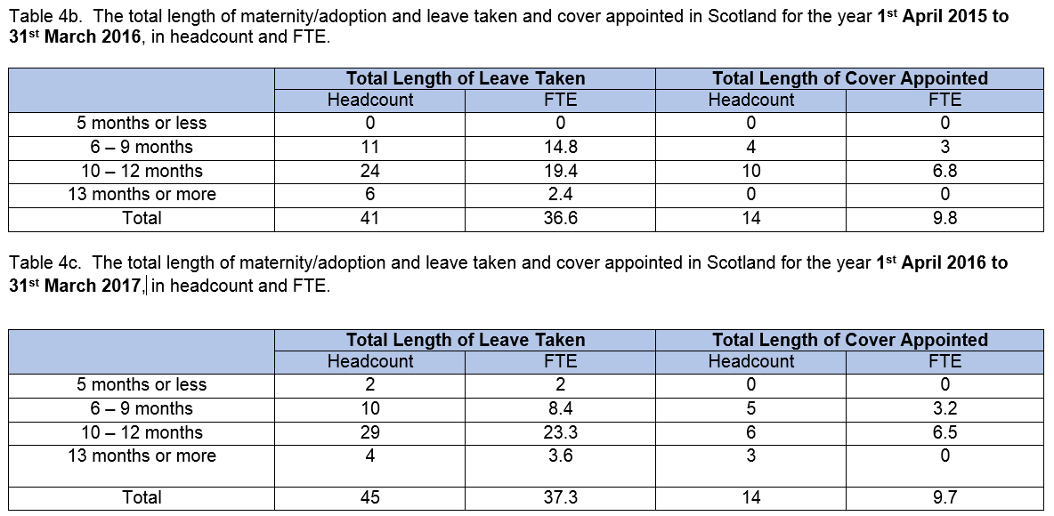

Slide 5
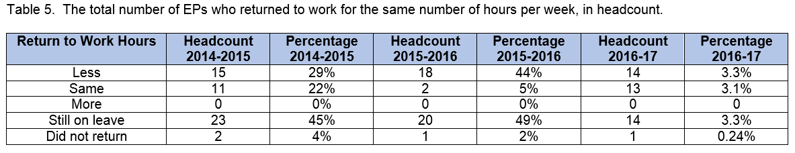
Maternity / Paternity Leave

Slide 6
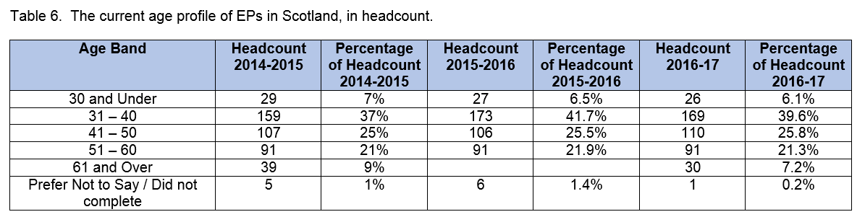
Age Profile

Slide 7
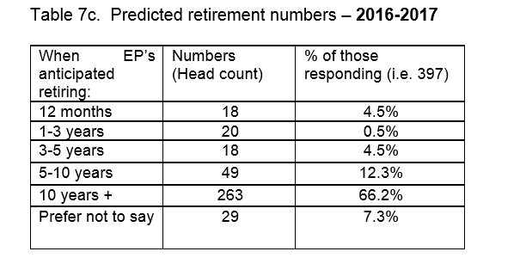
Predicted retirement numbers

Slide 8
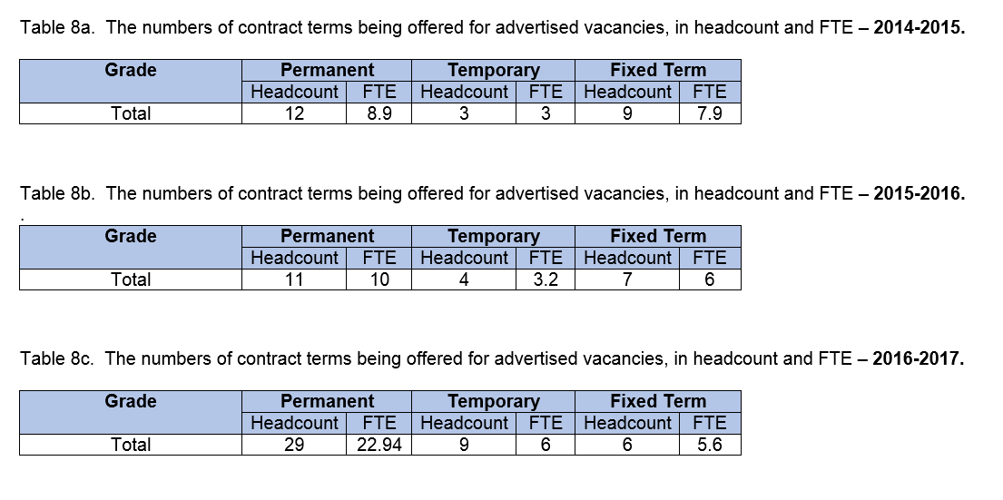
Types of contract offered

Slide 9
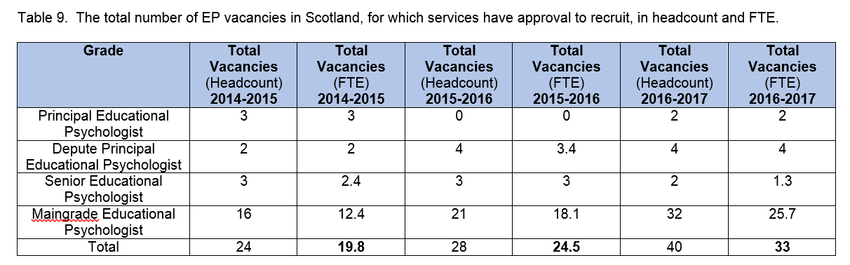
Approval to recruit

Slide 10
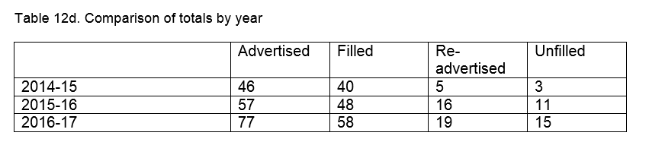
Comparison of jobs advertised against jobs filled and those re-advertised

Slide 11
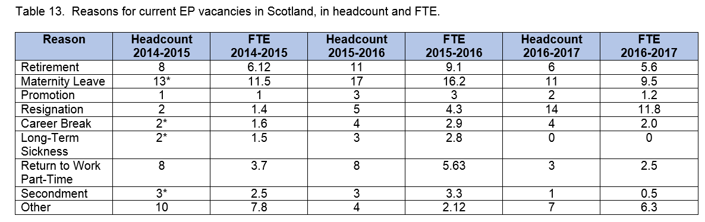
Reason for EP Vacancies

Slide 12
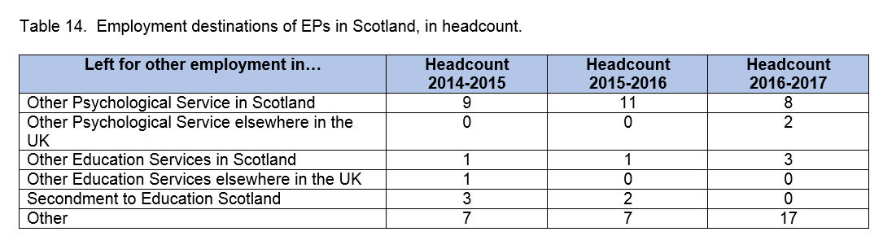
Employment destinations

Slide 13
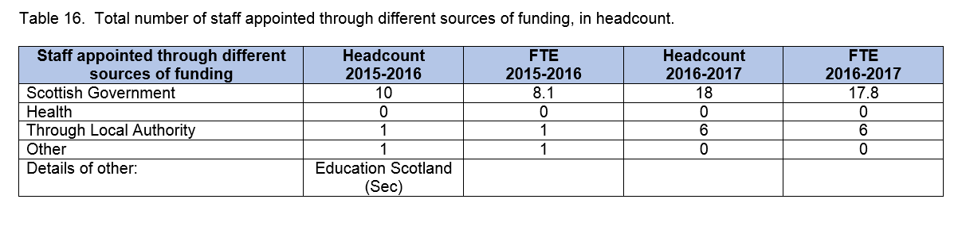
Funding sources

Slide 14
Future Projections based on actual staffing

Slide 15
Summary
We require at least 23 trainees qualifying per year to maintain and grow the workforce to staffing complement.
Data shows that although staffing complement has not really changed, in actual numbers it continues to fall consistently by 10-14 posts
Services are now reporting that they cannot fill vacancies, and when they are filled it often results in losses to other services creating an “HR Merry-go-round”. Data now supports this, see Table 12d.
Each year we have 45 (38 FTE) on maternity/paternity leave with no backfill.
There is a ongoing reduction in promoted posts.

Slide 16
Questions

