Slide 1
ASPEP – Inclusion Seminar Helena Jones & Craig Fowler
Communication Supportive Settings
Notes:
This presentation/input is specific to ELC but we have versions of the same presentation for primary and secondary audiences.

Slide 2
By the time we are finished We will
understand that inclusive communication is a universal approach and benefits all
understand the different modes of communication and how they support learning
identify areas for development on a plan and understand where to
access support
Notes:
This is a whole school approach that will benefit everybody. This is about rethinking a whole-school ethos and culture and making inclusive communication the responsibility of all.
It explains that there are many different forms of communication, some simple and some more complex.
It provides the setting insight into what is achievable and what they can do to be making a difference through self assessment and planning.

Slide 3
The National Standard says
The setting will
Be accessible to all children
Work in partnership with other agencies
The practice, policies and procedures in their setting are in line with the equality Act 2010 and are meeting the Health and Social care Standards
“ I am accepted and valued whatever my needs, ability, gender, age, faith,
Notes:
This slide applies to early learning centres and child care.
If we were delivering to primary or secondary school settings we would refer to the appropriate legislation the handbook.
There are different versions of the handbook specific to ELC, and schools.

Slide 4



&
Communication
Notes:
This was developed through a multiagency working group comprising of SLT, EPS, ESO (ASN), MAS, SES, EAL and representatives from ELC and schools.
The blue communication symbol is an increasingly recognised symbol for an inclusive communication environment. The important thing to note is that the arrow goes both ways in the symbol so communication is clearly a two-way process with responsibility on both sides (especially the grown ups!).

Slide 5
What does it feel like when we miscommunicate
Video
EAL Activity
Whisper Activity
Signing Activity
Notes:
The activity selected is dependant on whom is delivering the input and their specialist knowledge and skills.

Slide 6
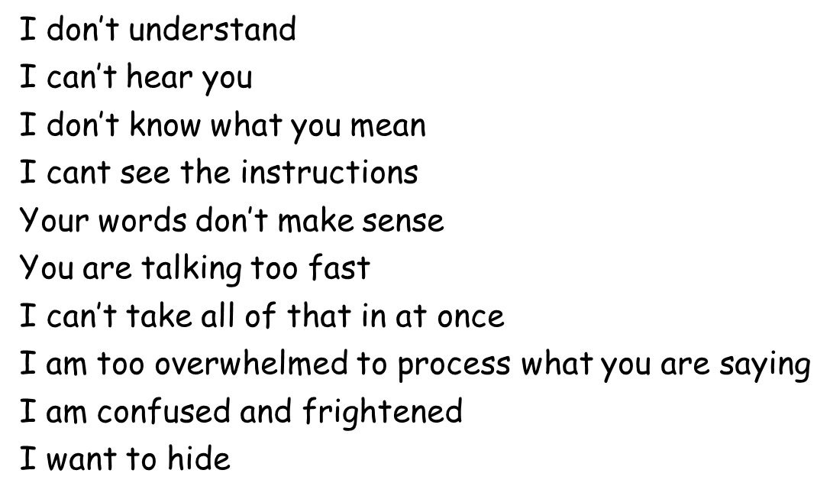
What does it feel like?
Activity
Notes:
Summary of participant responses from activity (generally).

Slide 7
Inclusive Communication is….
knowing where there are barriers to communication
creating a supportive and effective communication environment
using every available means of communication as appropriate to children’s needs
to understand and be understood
Getting It Right For Every Child
Notes:
The import thing here is about knowing what the barrier to communication can be (often know by knowing the child – A whole-school; relational approach plus learner profiles makes this job a lot easier).
Barriers to communication is discussed with the group – the more obvious ones tend to come up first and are generally followed by a recognition that language development and skills can be a barrier e.g. exposure to or lack of vocabulary heard at home, differing levels of emotional literacy, self-regulation, medical difficulties, neurodevelopment conditions etc.
Once the barriers are acknowledged and recognised there is motivation to create inclusive communication environments. The point is made that every available means of communication is ok. In fact, valued. TOTAL COMMUNICATION. Not being scared to do try because it is thought to be the wrong message.
It is about being understanding and being understood.

Slide 8
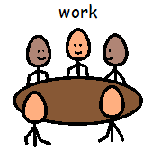
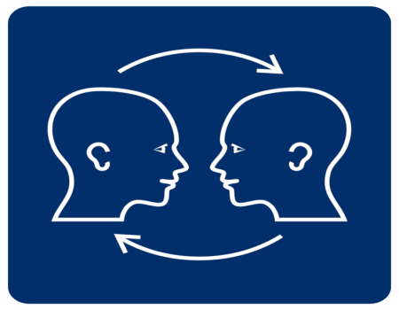
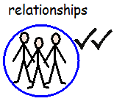
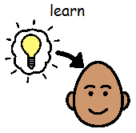

Effective Contributors
Confident Individuals
Successful Learners
Responsible Citizens
Notes:
The four capacities in symbol form. This demonstrates how easy it is to use pictures to communicate quite complicated constructs/concepts.
SLT – good practice states that the word(s) should be written in comic sans above the symbol/image. Should be standard practice.

Slide 9


How will I know I am in an Inclusive Communication setting?
Task: Think, Pair and share- What does it look, feel, sound, like ?

Slide 10
I have a voice and am heard.
The communication methods that work best for me will be used and valued by others.
The communication tools, techniques or technology I need are available to me throughout my life.
People communicate effectively with me because of their underpinning knowledge, skills and attitude.
People actively listen to me and take time to support my communication by encouraging and responding to all forms of communication.

Slide 11
People create opportunities for me to build confidence as a communicator.
I get the professional support I need to enable me to communicate to my full potential.
People work closely with my family so that they can support my language development and communication at home.
Policies and strategies that affect me take into account my communication and include me in appropriate ways.
Notes:
This information is of particular importance when considering planning for a setting.

Slide 12
SAFE By:
Expressing needs through requesting and refusing
Reducing victimisation as a result of SLCN
Being able to disclose when they are at risk of or are actually coming to harm
Understanding when they are at risk and thereby avoiding exposing themselves to harm.
HEALTHY By:
Expressing their feelings
Developing their ability to identify and regulate their emotions
Build successful relationships and maintain social closeness
ACTIVE By:
Commenting
Sharing opinions
Asking for and giving information in order to learn and negotiate socially
Access appropriate interventions and support
Getting It Right For Every Child
Notes:
To enable a setting to get it right for every child/YP the wellbeing indicators have been applied through an inclusive communication lens.
This is an effective tool to use when working with practitioners who truly understand GIRFEC.
HARD HITTING - SAFE – to be safe a child/yp needs to be able to disclose that you are at risk. If there is a barrier to communication then this is more challenging to disclose.

Slide 13
NURTURED By:
Developing and maintaining non-verbal communication as the bedrock of secure attachment
Being informed about people and events in their lives
Interacting socially with others
RESPECTED By:
Being listened and responded to – even if the answer is no
Understanding and expressing their views and preferences
Being spoken to directly and not spoken about
Being treated with respect and dignity
ACHIEVING By:
Accessing opportunities to be active participants in play and learning
Accessing Alternative and Augmentative forms of Communication at all times
Accessing the content and understand the purpose of learning
Getting It Right For Every Child

Slide 14
RESPONSIBLE By:
Understanding rules and norms of behaviour
Having opportunities to make meaningful choices including choices about how to behave
Have their behaviour understood as often indicating underlying or hidden speech, language and communication needs
INCLUDED BY:
Having their views and opinions sought out and listened to in discussion about their support and their future
Being valued and included socially and educationally
Communicating in a culturally and linguistically appropriate way
Getting It Right For Every Child

Slide 15
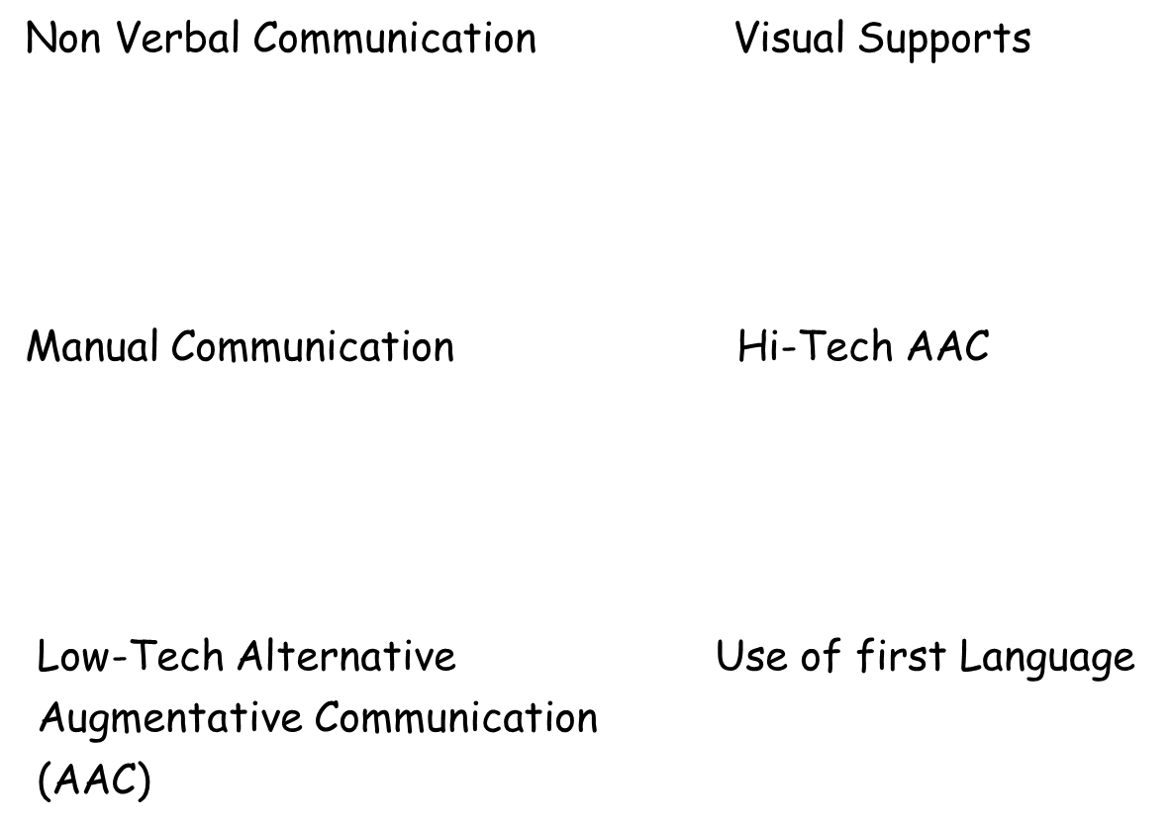
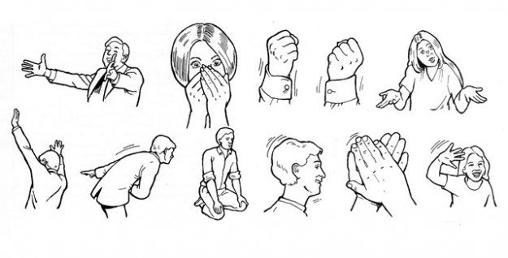


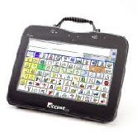

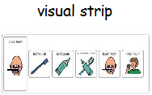
Approaches Include
Notes:
Then we talk about the approaches which start with the practitioner themselves, leading up to high tech augmentative communication devises.
The emphasis is on using low tech communication to teach communication skills before moving to the more high tech options or learning to sign.

Slide 16
Complete the questionnaire in your handout
Stop !
Notes:
School audit tool used here (page 11 in the handbook) – completed individually – self reflection so not a group task.
Starts with the mores straight forward communication methods e.g. allow time to respond, to some of the more complicated and specialist communication methods such as PODD (Pragmatic Organisational Dynamic Display).

Slide 17
Universal Communication Support
Allow time to process information
Minimise or stop using words and voice
Use Non-verbal communication cues: facial expression, tone of voice, body language
Natural Gesture
Visual cues and clues
Environmental cues and clues ( music, bells)
Objects of reference, Transition objects
Written labels / Instructions
Organisational tools such as schedules and job lists
Visual recipes, cartoon strips, video demonstrations
Clicker
Symbol labelling of environment - Boardmaker
Widget
Visual Timetables
Any other ways to communicate

Slide 18
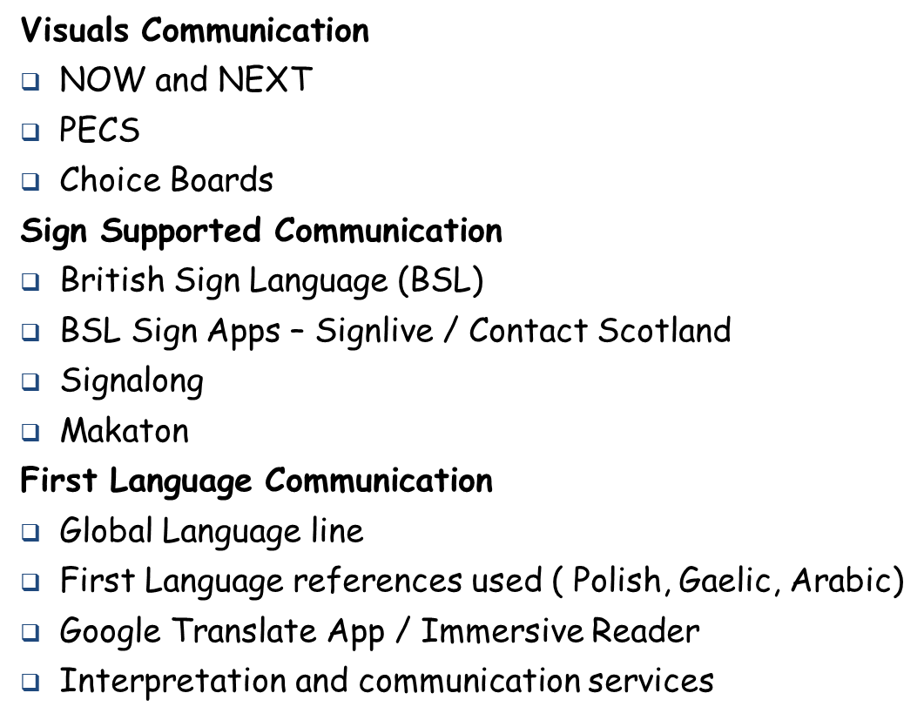
More Targeted Support

Slide 19
Targeted Support that we can learn
SCERTS - Social Communication and Emotional Regulation and Transactional Support
Intensive Interaction
Talking Mats
Communication Books
PODD – Pragmatic Organisation Dynamic Display
VOCA - Voice Output Communication Aids
Other ICT and Apps
Other Communication Technology

Slide 20






Training Opportunities
Moray Autism
Service (MAS)
English as an Additional Language Service
Moray Sensory
Education Service
Early Years
Education Service
Moray Educational Psychology Service
Moray
SEBN Service
Moray Education
and ELC Officers
Notes:
These are all services who available to practitioners to support inclusive communication development work.
List of training opportunities within page 14 of the handbook.

Slide 21
Creating a Plan
Need Identified from Self Evaluation Tool | Desired Outcomes | What will make this happen | Who will lead and by when | Impact Wellbeing indicators
Environmental Boardmaker symbols not used consistently throughout | Everyone will know how to use 10 basic symbols: hello, toilet quiet, more, wait, look, | Purchase Boardmaker Training on use of symbols Make symbols for each class (for wall)
Environments are not communication friendly | All rooms follow our Inclusive Communication Charter | Inclusive Communication group set up to create a an Inclusive Communication charter (staff and pupils)
Notes:
How to create a plan.
Form an implementation team within your establishment to developed a small or larger scale element of inclusive communication.

Slide 22
What Next?
Multiagency team delivery which offers wide perspective and choice
A clear and consistent message regarding inclusive communication from all services in Moray
Achievement of improved relationships between partner agencies with much shared learning and experience
It contains a self-evaluation and planning tool in their own context which empowers settings to effect positive change
Identified need for a post training support for settings
Identified need for a strategic approach to further inclusive communication training
Authority structures – need for a consistent message from all central teams – schools & curriculum and Educational Support Service

