Slide 1
Supporting Looked After Children and Young People to re-engage with education
Carol Smith – LAC Inclusion officer (Education) Sarah Booth – Research Assistant EPS
Notes:
20-30 mins

Slide 2
Inclusion Officer
An Introduction to Carol’s role ……….
Notes:
Carol – introduction of her role

Slide 3
Scottish Attainment Challenge
To ensure that all care experienced children and young people receive the vital support they need – Be alert
To improve their life experiences, attainment and their educational outcomes – Take Action, Access opportunities
To have a clear focus on delivering equity and improving educational outcomes – Assess for services and support
To underpin the Getting it Right for Every Child (GIRFEC) approach in order to improve outcomes and support their wellbeing – Seek out opportunities
To work in collaboration and partnership on a multi-agency basis – Promote interests
To focus on improvement in literacy, numeracy and health and wellbeing – Further Action to improve outcomes
Notes:
Funding aims
Corporate Parenting principles

Slide 4
Scottish Attainment Challenge
The LAC Attainment Project
An intensive collaborative approach to fully engage 15 young people in the senior phase of education, at risk of care placement breakdown and lacking in educational engagement
Shared approach to support holistic and education needs to ensure high quality outcomes for our most vulnerable and to improve their life experience
Primary Focus for Initial Phase
Target group identified on a multi-agency basis, specific plan to engage in education, to achieve 5 SQA qualifications, strategies regularly reviewed to achieve positive educational outcomes and improve well-being, including emotional well-being,
Outreach teaching, individual learning packages, specific interventions and programmes developed to promote engagement and create positive experiences, support well-being, link/support with home, education
Intensive family support, support education package around social and emotional needs, improve relationships between home and school, support and help to sustain care and education placement
Notes:
Sarah, this was the slide I created for Jennyfer, can we use it or are we happy with what we have in the next two slides?

Slide 5
West Lothian Attainment Project - Aims
Joint board created across education and social policy
Established an intensive, multi-agency approach to re-engage 15 young people in the senior phase of education (S4-S6)
To support holistic care and health and well-being
Focused support for young people who are particularly at risk of care placement breakdown, who have 50% or less attendance and for those with negligible engagement with education.
To improve attainment by supporting young people to achieve 5 or more National Qualifications
This will in turn support young people to achieve positive destinations into further education / employment
Notes:
We used this funding to develop our project…

Slide 6
West Lothian Attainment project – Key Features
Joint approach to improve relationships between home and school, support and help to sustain care and education placement and improve emotional wellbeing
Multi agency staff; Inclusion Officer, Outreach Teachers, MCMC worker, Family Support workers,
Outreach teaching develops individual learning bespoke packages, to promote engagement and create positive experiences, support well-being, link/support with home and education
Intensive family support role, supports education package with regular multi-agency review and planning
Various interventions including Martial Arts programme, Cooking groups, Health and Well-Being programme, Youth Action programmes, one to one outreach sessions, Outdoor activities, Cultural visits, joint working with residential house staff and Summer Programme
Notes:
SPECIFIC INTERVENTIONS
Two small group sessions delivered at West Lothian College on two afternoons. During these sessions the young people are supported in their SQA qualifications.
We are continuing to work with partners through the delivery of the ‘Rival School of Martial Arts’ program
MME, a small Health and Well-Being group, which is also delivered at West Lothian College.
A cooking session is delivered one morning per week
Various one to one sessions with family support worker
Various one to one education sessions
Various one to one MCMC support
Joint working with the Inclusion and Well-Being Service
Joint working with Residential Houses

Slide 7
1:1 outreach sessions
Literacy & Numeracy support
Health & Wellbeing Group
YAP
SQA qualifications
Bike Maintenance
Rival Martial Arts
Makeup group
Consequential thinking
Summer programme
Cultural visits
Photography
Practical Cookery
Notes:
Specific Interventions offered include…
1:1 outreach sessions
SQA qualifications
Literacy support, joint work with IWS
Numeracy support
Health and Well-Being group
The Rival Martial Arts Programme
Practical Cookery
West Lothian College
Bike Mainteanance, joint work with IWS
Youth Action Project, Make Up group and Photogrophy course
Joint work with Residential House staff
Family Support worker sessions, Arts and Crafts, Outdoor Learning, Gardening, Cycling
Cultural visits
The Summer Programme
Youth Vision programme
Consequential Thinking, IWS
Emotional Well-Being

Slide 8
Measuring Impact
Attendance to sessions
Attainment data
Pupil voice – online survey
Participation and Engagement - teacher tracking
Positive Destinations - MCMC
Care Placement
Measuring Success Booklet FSW (Self-esteem; eco-maps; community engagement - in development)
Notes:
My role; put measures in place to evidence the impact of this project for our children and young people
This feeds into a quarterly report to keep all partners up to date on project progress. Spending information is also recorded here for Scottish government
“Measures should reflect the strategic decisions taken around how the funding is used and local authorities should agree the mechanisms which best illustrate impact on attainment.”
COLLABORATION: All project members contribute to the evaluation of the project
Initial focus of the funding: Improve attainment and positive destinations
Interest in capturing additional outcomes as well; relationships, confidence (self-esteem), etc.

Slide 9
SCALE OF PUPIL ENGAGEMENT IN LEARNING
1 | Extremely low | No concentration: staring, daydreaming; An absent, passive attitude No goal-oriented activity, aimless actions, not producing anything No signs of exploration and interest Not taking anything in, no mental activity
2 | Low | Limited concentration; looks away during the activity, fiddles, dreams Is easily distracted Action only leads to limited results
3 | Moderate | Routine actions, attention is superficial Is not absorbed in the activity, activities are short lived Limited motivation, no real dedication, does not feel challenged Does not gain deep-level experiences Does not use his/her capabilities to full extent The activity does not address the imagination
4 | High | Is engaged in the activity without interruption Most of the time there is real concentration, but during some brief moments the attention is more superficial Feeling of challenge, there is a certain degree of motivation Capabilities and imagination are addressed in the activity
5 | Extremely high | Is absolutely focussed, concentrated without interruption Is highly motivated, feels strongly appealed by the activity Even strong stimuli cannot distract him/her Is alert, has attention for details, shows precision Mental activity and experience are intense Constantly addresses all its capabilities: imagination and mental capacity are in top gear Obviously enjoys being engrossed in the activity

Slide 10
SCALE OF PUPIL PARTICIPATION IN WIDER LEARNING
1 | Extremely low | Declines wider learning opportunities Has no interest in wider learning opportunities Parents/carers do not engage or support wider learning
2 | Low | Can be persuaded to engage with wider learning opportunities Shows little interest in wider learning opportunities Parents/carers show minimal engagement or support for wider learning
3 | Moderate | Will engage with wider learning opportunities Shows some interest in wider learning opportunities Parents/carers show some engagement or support for wider learning
4 | High | Volunteers for additional wider learning opportunities Seeks opportunities to further learning in varied contexts Parents/carers are engaged in and support wider learning in and out of school
5 | Extremely high | Eagerly volunteers for additional wider learning opportunities Actively seeks opportunities to further learning in varied contexts Parents/carers are highly engaged in and support a high level of wider learning in and out of school

Slide 11
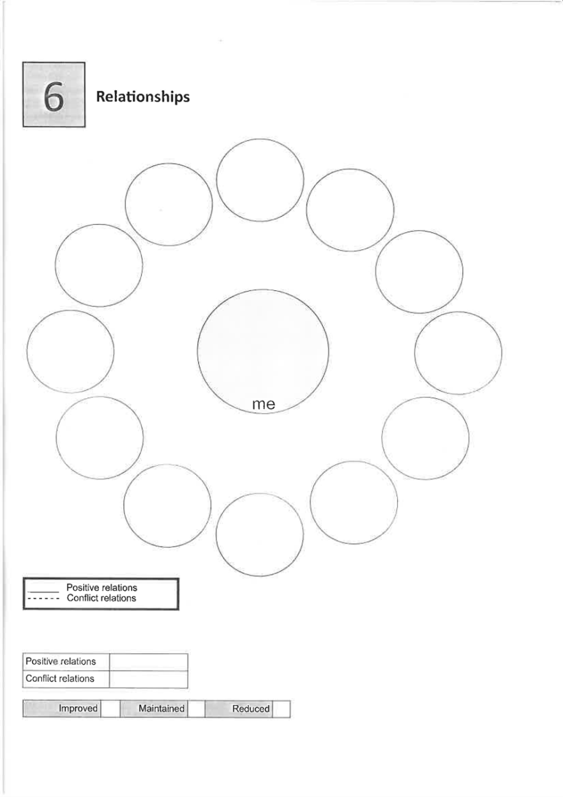
Notes:
Capturing more than attainment…
Measuring success book created with social work
Eco maps tool
Not only a measure but useful exercise
Demonstrates impact over and above attainment

Slide 12
Outcomes from Pilot phase
Improved attendance
Increased participation and engagement
80% - 5 or more National Qualifications
100% - positive destinations
100% - feeling more supported with their education
86% - reported feeling more engaged with their education
Notes:
15 pupils
Project began in late 2018; phase one = academic year 2018-19
No exclusions
Key point re positive destinations – what happens after?

Slide 13
Phase 1: 2019-2020
MCMC worker, to support with employability and skills development, alternative pathways, positive destinations
Expand the scope of work to include early intervention, focus on S2/3 stage
Increase staffing to include advanced pupil support workers, sustain mainstream Cfe curriculum
Focus on young people in their qualifications year
Focus on young people returning from outwith placements
Focus on young people living in the residential houses
Focus on young people who are looked after at home
Consider summer activities for children Looked After at Home
Notes:
Reflect on Staffing challenges

Slide 14
Phase 1: 24 pupils
5 at S5 stage, 11 at S4, on track for qualifications and positive destinations
6 at S3 and 2 at S2; earlier intervention element – supporting pupils to maintain mainstream placements
Engagement/Participation/Opportunities
Additional staff, FSW/Advanced PSW
Individual/group interventions
Partnerships/Home, Bespoke packages
Notes:
Academic year 2019-20

Slide 15
Case Study
Interview
nerves and insecurity
Early 2019
Returned to WLC
Apply to course - Buzzing!
Offered a place!
June 2019 Achieved Level 4 English
February 2020
Achieving and doing well.
Sights set on University.
January 2020
Glasgow College
Construction course,
YAP,
Outdoor Activities
August 2019
Level 4 Maths and
Joinery
D the Conqueror!

Slide 16
Going forwards…
Increase the current project to enable access to a wider number of our most vulnerable pupils
Increase access to support at early stages; early intervention
Expand programmes of specific interventions
Consider summer activities for children looked after at home
Notes:
Reflection note; considering expansion when facing staffing challenges – how to reach the widest possible group of Looked After Children moving forwards

Slide 17
Our key aspects of practice around Inclusion
Improving educational outcomes with a flexible approach
Creating opportunities for new experiences
Promoting resilience and positive attachments
Building relationships with consistency
Collaboration between the services around children and young people
Notes:
“24 hour curriculum”

Slide 18
Quick feedback from pupils…
“I enjoy coming to college with my peers and Outreach Teachers”
“I enjoy our sessions”
“The support is brilliant”
“I would like to go back to school to complete my studies now”

Slide 19
Thank you for listening
sarah.booth@westlothian.gov.uk
carol.smith@westlothian.gov.uk

